Slide 1


DEC 03, 2024
Deel Advocates
OFFICIAL CUSTOMER ADVOCACY PROGRAM
Contact us at advocates@deel.com with any questions.

Slide 2





DEEL ADVOCATES
‹#›
Share your success.
Earn rewards.
Share your experience in one-to-one meetings with potential customers and peers.
Connect
Improve
Influence
Rewards
Connect with peers who want to hear about your experience using Deel. Our team can help match you to peers that you want to learn from.
By connecting, you’ll be taught. Learn how peers have achieved breakthroughs. Earn extra consulting hours with our team.
You'll get exclusive invites to participate in videos, webinars, and other thought leadership opportunities—helping you grow your personal brand as an HR influencer.
Earn points every time you meet with a peer. Enjoy exclusive Deel Advocates swag.

Slide 3

DEEL ADVOCATES
‹#›
Welcome
Our customers’ success is our
most powerful story.
Welcome again! If you ever have questions or feedback, feel free to reach out to me directly at spencer.cook@deel.com.
Together, we’ll create something truly special—where HR leaders like you are helping each other grow and achieve even more.
Spencer Cook Deel Advocates Lead
I’m thrilled to welcome you to Deel Advocates! Our goal is to build the world’s best customer advocacy program, and you’re now a key part of it.
This exclusive community is reserved for customers like you—leaders who are achieving breakthroughs and shaping the future of HR. As a Deel Advocate, you’ll have the opportunity to share your success story, connect with industry peers, and earn rewards that elevate your career.
Our mission goes beyond rewards—we want to help you grow your personal brand as a thought leader and extend your influence in the HR space. Through Deel Advocates, you’ll connect with passionate professionals from around the world, sparking valuable conversations that energize and inspire.

Slide 4

We make it easy to share your experience and earn rewards.

Slide 5




DEEL ADVOCATES
‹#›
What makes a great advocate?
There are three things that make a great advocate:
Completed the implementation of Deel.
Are either a decision maker or program manager. A decision maker is responsible for choosing Deel and business results. Program managers are individuals who are more technical and using Deel frequently.
Enjoy talking to peers
Notes:
Over the next 1-3 Weeks

Slide 6







What do advocates do?
Advocates are required to be willing to meet with a peer at least once a quarter. These meetings should be personal and authentic. Deel employees usually don’t join these meetings, ensuring advocates get the spotlight. Advocates will also have the opportunity to participate in public activities like case studies, videos, webinars, etc. but these are not required. Any public activities will be approved by the advocate.
Required
Optional
Optional
Optional
Peer Meetings
Webinars
Videos
Media Interviews
Optional
Optional
Optional
Press Release
Quotes
Web Reviews

Slide 7
DEEL ADVOCATES
‹#›
Advocate Experience
1
2
3
4
Register
Profile
Connect
Reward
Sign up. Share which Deel products you are willing to talk about, how often you want to be contacted, and any public activities you are interested in.
We’ll use your registration details to make a profile in our database.
We’ll match you with peers looking to talk to someone and help arrange the meeting.
After meeting with the peer, you’ll earn points to use in our Rewards Store.

Slide 8
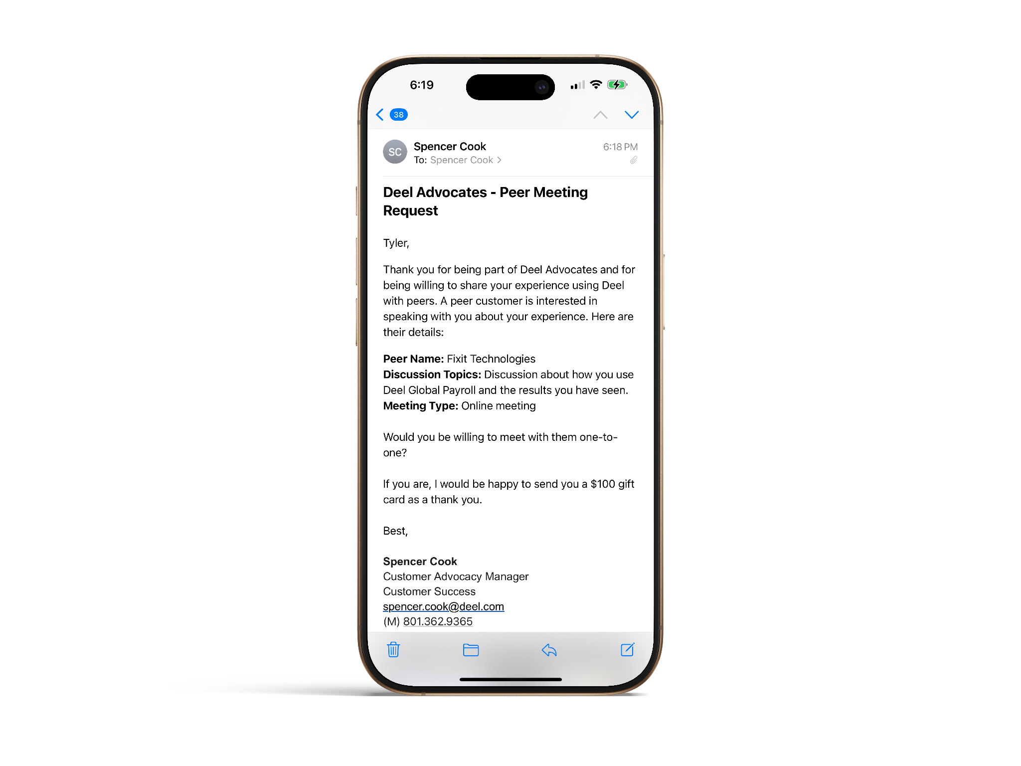
DEEL ADVOCATES
‹#›
Example Peer Meeting Request

Slide 9

DEEL ADVOCATES
‹#›
Rewards Store

Slide 10
DEEL ADVOCATES
‹#›
How to earn points
Earn points for each activity and redeem them anytime in your online wallet.
1 point
Web review
1 points
Sales reference
4 points
Press Release
5 points
Webinar
5 points
Case Study

Slide 11
DEEL ADVOCATES
‹#›
How to spend points
Log into your Deel Advocates account to check your balance. Redeem your points at anytime.
1 point
Gift card
2 points
Deel swag
5 points
Deel billing credits
8 points
Private executive meeting

Slide 12

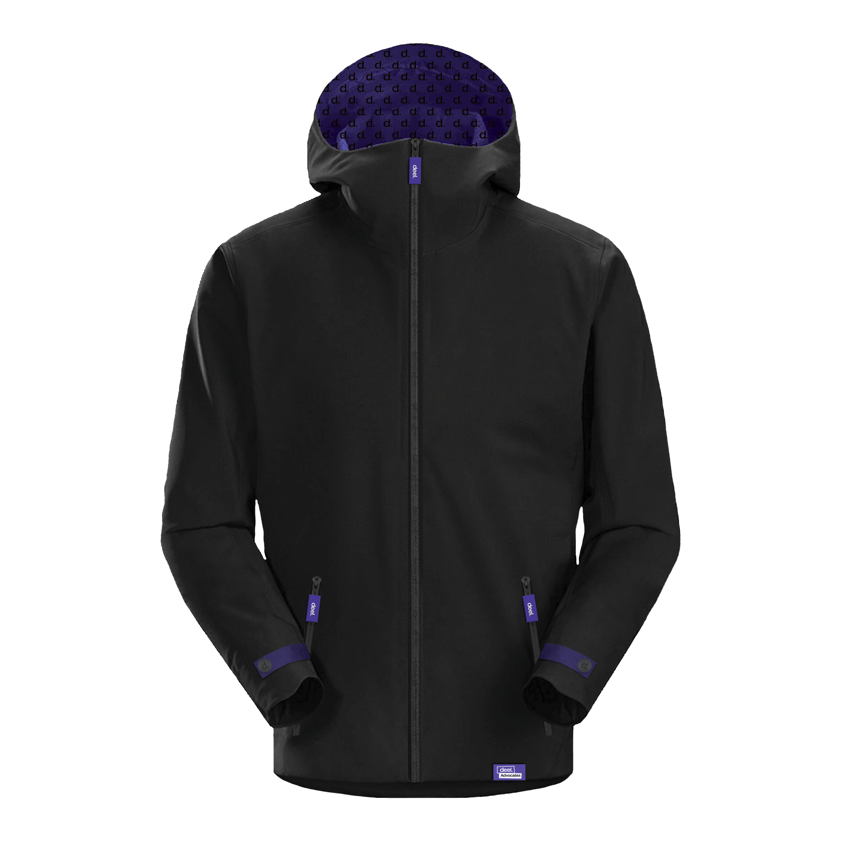
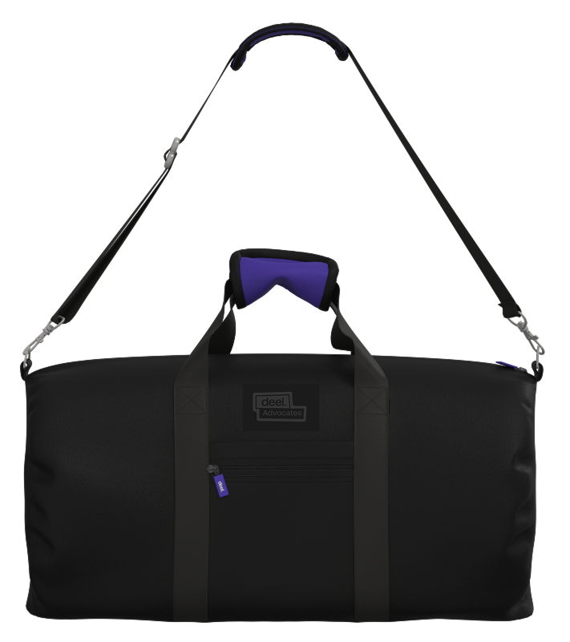

DEEL ADVOCATES
‹#›
Exclusive
Swag

Slide 13
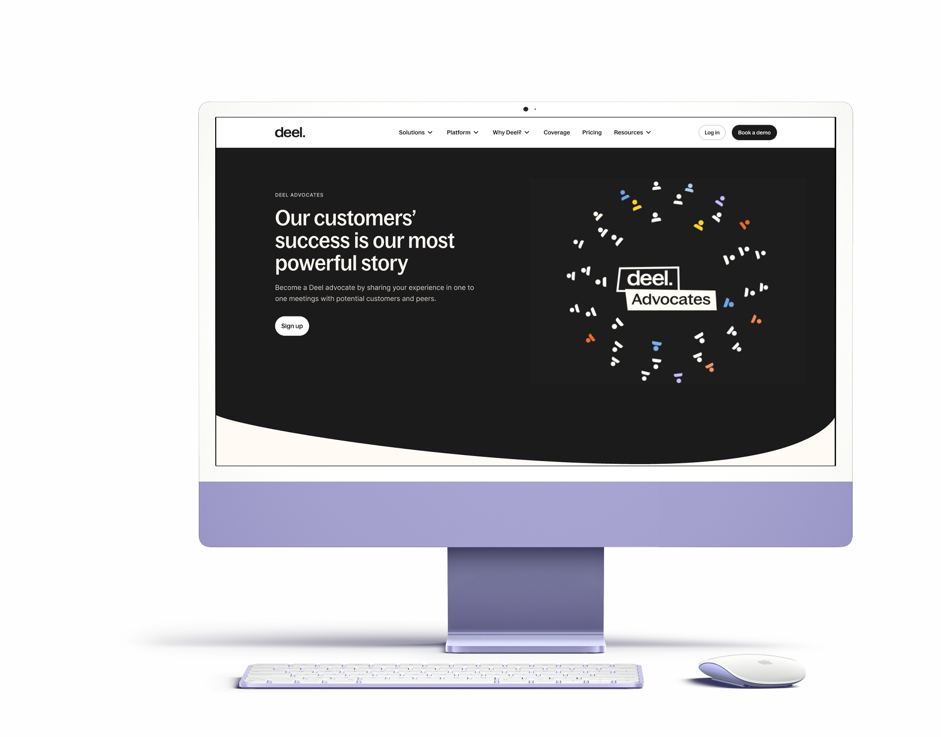
DEEL ADVOCATES
‹#›
deel.com/advocates

Slide 14
DEC 03, 2024
Deel Advocates
OFFICIAL CUSTOMER ADVOCACY PROGRAM
Contact us at advocates@deel.com with any questions.

